Slide 1
Capstone Project
The Battle of Neighbourhoods

Slide 2
Identifying new F&B market opportunities in Singapore
Singapore is a country with a very diverse culture.
Singapore generated 18.5 Million International Visitor Arrivals (IVA) in 2018, an increase of 6.2% as per Singapore Tourism Board (STB)
Aim is to identify new market opportunities/potential businesses in Singapore, particularly in Central Area using Foursquare API
Target audience is potential investors/business owners

Slide 3
Data Source and Data Cleaning
Singapore boundary data to identify sub-zones and regions in Singapore from Data.gov.sg
The master plan subzone boundary for 2014 shows the division of the zones
MyGeodata Converter is used to convert the file from KML/SHP formats to CSV for analysis
CSV data is stored in Github repository for ease of access

Slide 4
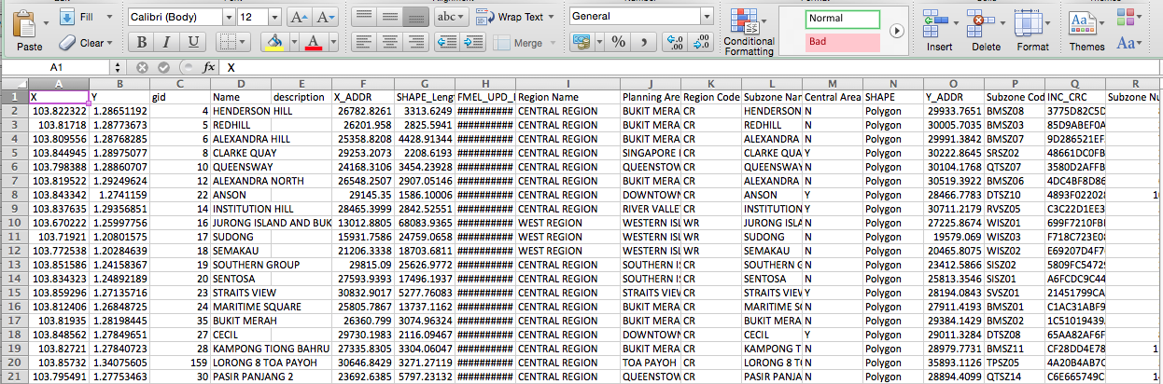
Snaphot of CSV data
Y and X columns give the latitude and longitudes, respectively
The sub-zones fall under 5 regions, namely: Central Region, West Region, North-East Region, East Region and North Region
Central Area Indicator indicates whether the subzone can be found in the central area

Slide 5
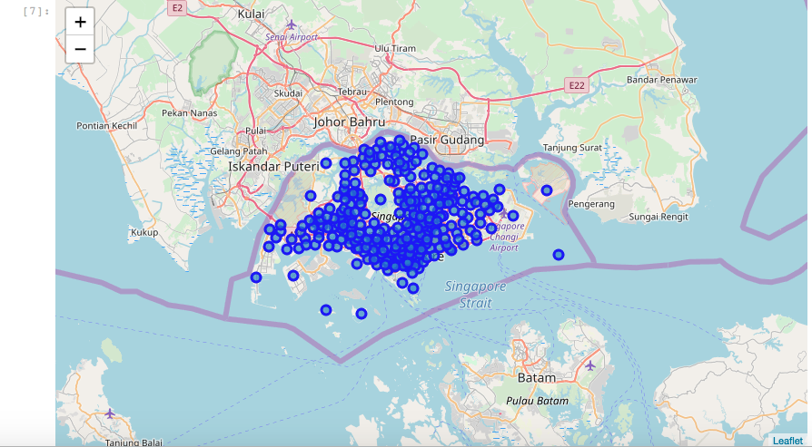
Using Folium to create a Map of Singapore with the sub-zones superimposed

Slide 6
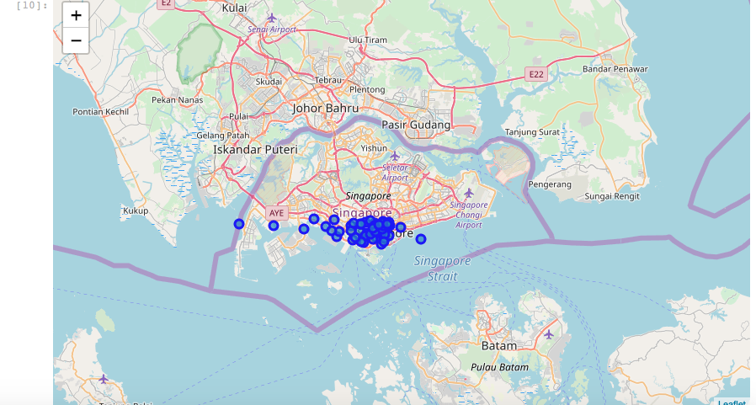
Exploring Central Area
Central Area Indicator = ‘Y’
Visualize the Central Area using Folium

Slide 7
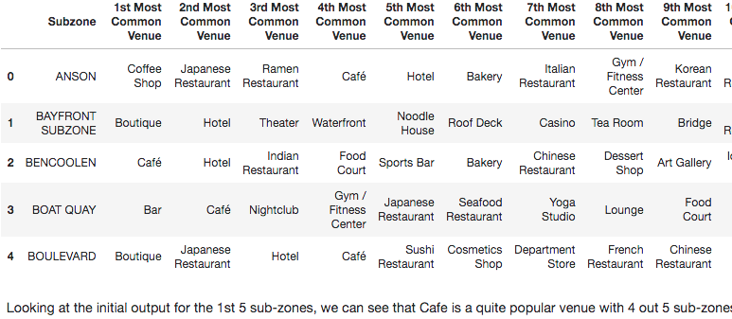
Using Foursquare API to get the top 10 most common venues within 500 meter radius

Slide 8
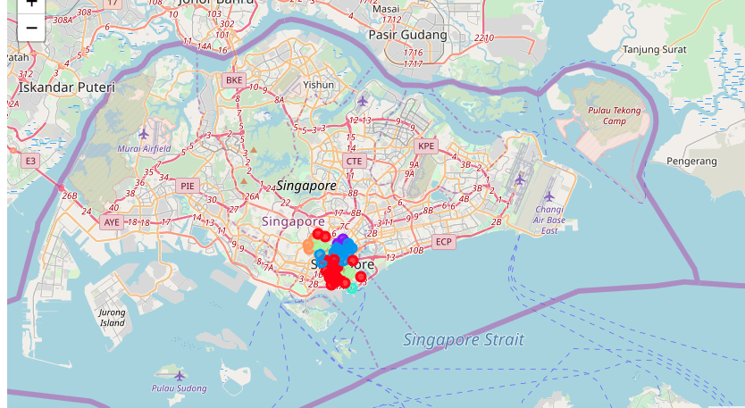
Clustering the Central Area sub-zones using K-means, clusters set to 6 and using Folium to visualize the clusters

Slide 9
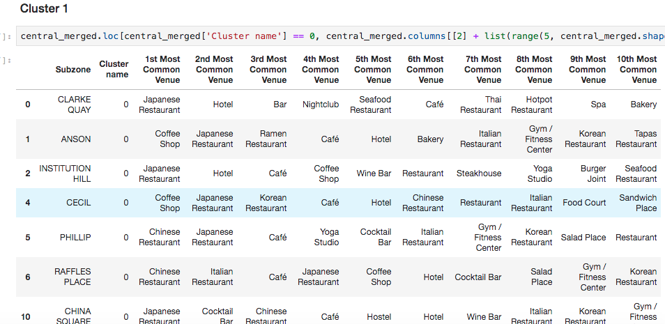
Cluster 1 could be described as Asian Restaurant venue given the number of Japanese and Chinese Restaurants

Slide 10
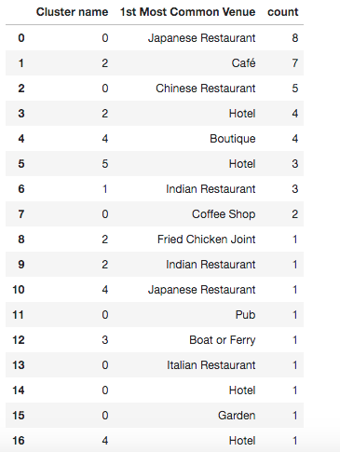
Cluster 2 - Indian Restaurant Venue
Cluster 3 - Hotel and Café Venue
Cluster 4 – Water Venue
Cluster 5 – Botique Venue
Cluster 6 – Hotel Venue

Slide 11
Conclusion
There is clear market opportunity for increasing the number of F&B outlets in the Central Area of Singapore.
Analysis could be expanded to include the number of IVA in Singapore to determine what cuisines would be mostly preferred based on the country of the origin of the tourists
Analysis could be done using different regions of Singapore and compare that with the results from the Central Area

